Slide 1






Online Training Module
E-learning Training Module
Updated November 2024
Notes:
Welcome, everyone! Thank you for joining today's e-learning module, where we will provide an overview of the Let’s Get Cookin’ program. This program was developed by Public Health Dietitians at the Middlesex-London Health Unit and has been adapted with permission for use in Huron and Perth Counties. Let’s Get Cookin’ is an evidence-based program offered through Middlesex-London, Southwestern and Huron Perth Public Health Units.
This session is designed to give you all the essential information you'll need to successfully facilitate the program. We recommend all program facilitators review this module. Let’s Get Cookin’ was developed in consultation with Public Health Inspectors to ensure appropriate safe food handling principles are followed.

Slide 2
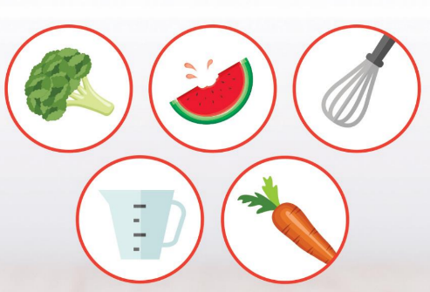
Training
Agenda
Program Rationale, Goals & Values
Before you Begin
Safety in the Kitchen (Basic Knife & Food Safety)
Participant Orientation
Program Format
Cooking Sessions
Test your Knowledge
Notes:
This session will start off with the Program Rationale and Goals & Values of the program, before getting into what you need to know Before You Begin the program. We will cover some essential food and knife safety in the kitchen, then we will move into Participant Orientation, the program format and setting up Cooking Sessions. Throughout the module, we’ll dive into each of these topics in detail to ensure you have all the information you need to effectively facilitate the program.
At the end, you’ll be asked to complete a short quiz to test your understanding, so make sure to take note of the key points as we go along.

Slide 3
Program Rationale
Canada’s Food Guide recommends a variety of vegetables and fruit, whole grains, and protein foods with an emphasis on plant-based proteins to support health and well-being.
Each recipe includes a vegetable and/or fruit.​
Participants learn to make tasty recipes that increase vegetable and/or fruit intake.
​​There is a focus on plant-based proteins. ​
Let's Get Cookin' uses a food exploration-based approach to learning.
Notes:
Evidence shows that teaching children about nutrients and why some foods are more nutritious than others does not have a big impact on their food choices. Focusing on food exploration, inspiring curiosity about food, and creating opportunities to have positive experiences with a variety of nutritious foods, has a greater influence on food acceptance and healthy food behaviour in the long-run.
Let’s Get Cookin’ is designed to provide exposure to a variety of vegetables, fruits, whole grains, and plant-based, protein-rich foods. These foods have nutrition benefits to promote health and well-being, but the focus is on learning what you can do with these foods rather than on why they might be beneficial.
Every recipe incorporates at least one vegetable or fruit, allowing participants to learn how to create tasty meals that include these nutrient-rich foods. The program also highlights plant-based proteins such as beans and legumes. Beans and legumes are a low-cost protein food that’s also high in fibre, vegetarian, readily accessible and may be a food some students haven’t explored before.

Slide 4
Program Rationale
Canada’s Food Guide suggests cooking more often and eating with others to help children and youth develop positive eating habits.
Cooking from scratch is associated with improved intake of vegetables, fruit and whole grains.
Teaching children and youth cooking skills fosters the development of basic life skills that they can continue to develop overtime.
Students are encouraged to sit and eat the food prepared together as part of the program.
Eating well is more than the foods we eat; food is social and there are many benefits to eating together.
Notes:
Cooking from scratch has been shown to improve the intake of vegetables, fruits, and whole grains. By introducing cooking and food literacy skills at a young age, we help children and youth develop essential life skills that they can continue to refine as they begin to take more responsibility for feeding themselves at home.
A key focus of this program is on basic cooking skills. It provides opportunities for students to work together and gain confidence with practical cooking skills. The program does not use ovens and is not focused on baking. Cooking allows more flexibility than baking and often relies on an oven—a tool not everyone has access to. Cooking also lends more opportunities to practice creativity, adaptability and learn how to transform what ingredients you have into a meal. Whereas baking often requires more specific ingredients and precise measurements.
Food and eating are social and there are numerous benefits to eating together as a group. Students are encouraged to sit down and enjoy the meals they’ve prepared together in the program. This experience fosters a sense of community and emboldens students to explore new foods along with their peers.

Slide 5

Program Rationale
Cooking has many cross-curricular connections. Revised Science and Technology Curriculum has incorporated food literacy
        Math
        Literacy
  Science
  Critical thinking
Notes:
Food literacy offers a range of cross-curricular connections, making it an enriching activity that goes beyond the kitchen. Through this program, participants will develop skills in: Math by Measuring ingredients, understanding fractions, and even budgeting for recipes. Literacy by Reading and interpreting recipes, understanding cooking terms, and following written instructions. Science by Exploring how different ingredients interact—such as how baking soda acts as a leavening agent. Critical Thinking in Cooking encourages problem-solving, following steps in the correct order, and working together as a team to prepare the final dish. By incorporating these diverse skills, cooking becomes a valuable learning experience that can support academic growth in multiple areas.
For more ideas for learning connections, check out the program resources available after you’ve completed this e-learning module.

Slide 6
Program
Values
Allergies
Facilitators can’t promise or control an allergen-free environment.
Body weight, shape, or size should not be a topic of discussion.
Goal of the program is to encourage skill building related to cooking and to foster a positive relationship with food.
Focus on food rather than nutrition
Focus discussions about cooking and food rather than on nutrition and healthy eating.
Notes:
When establishing your Let’s Get Cookin’ program, it’s important to keep the following core values in mind:
Firstly, Allergies: As a facilitator, it can be challenging to guarantee an allergen-free environment or ingredients. To help manage this, always share the recipes and ingredients with caregivers in advance, especially if any children have allergies. This allows them to decide whether they feel comfortable with their child’s participation.
Next, Weight and Calories: One of the key goals of this program is to build cooking skills. Conversations around weight, calories, or dieting should be avoided, as these are sensitive topics that aren’t the focus of Let’s Get Cookin’. Instead, the emphasis should remain on learning practical food preparation and cooking skills and focus on fostering a positive relationship with food. Discussions about weight management or controlling weight through diet are highly discouraged.
Finally, Focus on Food, Not Nutrition: Keep the focus of the program on the enjoyment of cooking and the process of working with food, rather than diving into discussions about nutrition or specific healthy eating habits. If you have time, explore how the foods you are preparing grow, what to look for at the farmers market or grocery store, and even how participants might want to adapt recipes at home. This helps maintain a positive and inclusive environment for all participants.

Slide 7

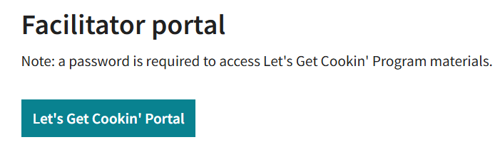
Let’s Get
Cookin’ Portal
The portal provides all the resources and recipes you will need to facilitate the program.
Portal login and password provided at completion of the training survey.
To get the most out of the program, facilitate all 7 sessions using the included recipes as laid out on the portal.
www.hpph.ca/LGCportal
Notes:
Let’s Get Cookin’ also has an online portal, which provides all the resources, details, and recipes needed to facilitate the program. After you complete the e-learning module, you will receive the login and password to access this portal. We do ask that you provide your name and contact information so that we can let you know if there are major changes to the program. You can opt out of receiving emails in the future at any time. Students will get the most out of the Let’s Get Cookin’ program, if you conduct all 7 sessions as outlined and follow the recipes as they are presented on the portal. This ensures consistency and helps maintain the integrity of the program.
If you are working with an older audience or looking for resources that can be used within a different program, the recipes are appropriate to be used for this purpose. Please keep safe food handling and kitchen safety in mind for your specific setting.

Slide 8
Before you Begin
Program costs:
Equipment cost: ~ $500.
Groceries: $30-$50 /session.
7 sessions: at least $210.
List for staple ingredients to facilitate the program is available on the portal and should be purchased prior to starting the program: ~$70.
* Calculated cost based on 2 cooking stations.
Notes:
The next few slides will walk you through important details to help plan before you begin the program and to ensure everything runs smoothly.
First, you'll need specific equipment to run the program. Some schools and programs may have all the equipment you’ll need already available, others may need to purchase items. The program is designed to be accessible for use in spaces with minimal kitchen facilities, but does have some space requirements we will talk about more later. The equipment kits we use cost around $500 and work well for groups of 10. This is based on purchasing items during sales, so your costs may vary. Once you have purchased the equipment, it should last for many years.
The ongoing cost is food. Groceries are expected to cost on average at least $30 per session. Over the course of six cooking sessions, plus the orientation session, you can expect a total grocery cost of at least $210. Depending on how close together or far apart you offer the sessions, leftover ingredients can often be saved for the next session.
It is recommended to purchase a supply of pantry staples. A list of staple ingredients needed for this program is available on the portal. This will increase your first grocery trip’s cost, but these ingredients will be used throughout all sessions. This staple kit will cost about $70 and many of these ingredients will last more than one set of seven sessions. These items are shelf-stable and will last many months.
These estimated costs are based on setting up two cooking stations (with 5 students per station). If you plan to accommodate a larger group and double the recipes, you may need additional equipment, which will increase your overall costs.

Slide 9

Before you Begin
Potential funding sources:
Parent council
Local businesses
Charitable organizations
Grants
Notes:
If cost poses a barrier to running the program, there are several avenues you can explore for funding or grants.
If you are in a school setting, consider reaching out to the parent council to see if they have funds available to assist with program expenses. Similarly, many local businesses and charitable organizations may be willing to support your program. Additionally, your school administrator or board may have suggestions for other funding opportunities, grants or resources that could be beneficial.

Slide 10
Before you Begin
Recruitment strategy:
Discuss with principal or manager. This could be an opportunity to engage youth who may be less connected in the school.
Poster and newsletter insert available on the portal.
Provide information about the program at staff meeting and discuss recruitment strategy.
Notes:
When recruiting participants for the program, consider the following strategies:
Speak with the principal or manager at your location to identify which youth would benefit most from the program. They may also have valuable insights and strategies for effectively recruiting participants.
Advertise! A sample recruitment poster is available on the portal. This poster is easily modifiable, allowing you to update the time, date, and location of your program, making it a practical tool for outreach.
Bring up recruitment strategies during staff meetings, engage your colleagues to help generate ideas , and ensure that everyone is on the same page regarding participant outreach.

Slide 11
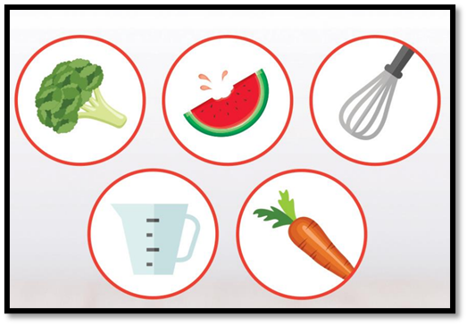
Before you Begin
Timing:
Will your program run during school hours or after school?
Each session takes about 1 hour, plus set-up
Location Needs:
Nearby sink/refrigerator
Electrical outlets
Adequate ventilation
Handwashing stations
Enough space to work safely
Notes:
Each session will take at least 1 hour to facilitate plus set-up time, which includes cleaning, sanitizing and setting up the room. Before you begin the program, consider what time of day the program will be held, and the location of the program. ​
When choosing the room location consider the following factors:​
There should be a sink and refrigerator close by​. Ensure there are enough electrical outlets. Ensure the room is adequately ventilated so that steam from a skillet will not set off the fire alarm. ​Consider how and where the participants will wash their hands. For example, is there a need to set up a portable handwashing station? ​Finally, ensure there is adequate space in the room so that all participants can work safely.​

Slide 12
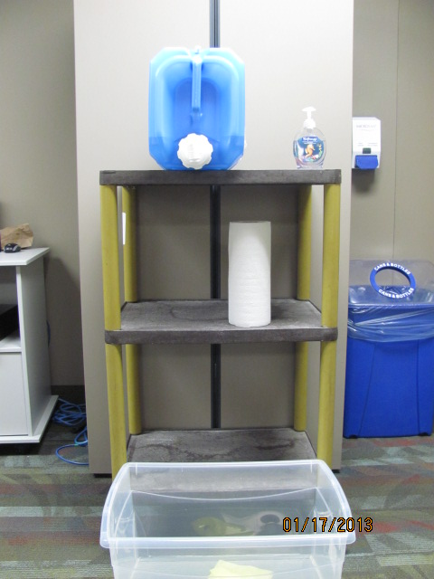
Before you Begin
Water Jug
Hand Soap
Paper Towels for Drying Hands
Catch Basin
Notes:
If a handwashing sink is not conveniently located near the cooking area, you can set up a portable handwashing station, similar to the one shown in the slide. To create this station, you’ll need: A portable water jug filled with very warm water, A table or cart to set the jug on, A plastic bin or catch basin to collect used water, and Hand soap and paper towels for drying hands. After using the portable water jug, be sure to properly drain and air it out after each use to prevent bacteria build up.

Slide 13
Before you Begin
Collect Participant Consent Forms
Collect signed consent form participants’ parent/guardian (sample available on portal)
Check with principal or manager to ensure consent form is appropriate for your location.
Ensure permission form is stored according to school/agency policy as they contain private information.
Notes:
All food preparation activities carry the potential risk for foodborne illness, cuts, burns and allergies. It is recommended that facilitators share a letter of information and obtain consent from a parent or guardian before starting the program. A sample letter and form is available on the portal. Please make sure to consult with your school principal or program manager to verify that the consent form meets the requirements for your specific organization and location.
Once you have collected the signed consent forms, it’s important to store them securely according to your school or agency’s policy, as they contain personal information. Be sure to speak with your school principal or manager to determine the appropriate storage location for confidential records.

Slide 14
Before you Begin
Room Set-Up
Clean and sanitize all tables where food preparation will occur
Equipment, utensils, dishes should be clean and sanitized
Set up the appropriate number of cooking stations needed based on the number of participants
Divide the participants into groups
Ingredients shared by both recipes can be placed on a common table (in middle of room)
At each station include: a couple of copies of the recipe, and all the equipment and ingredients that are noted on the recipes
Notes:
When setting up the room for the program, it’s important to begin by thoroughly cleaning and sanitizing all tables, surface areas, equipment, and dishes. Use soap and water, followed by a properly diluted food-grade sanitizer to ensure a hygienic environment.
Next, you will need to arrange the cooking stations for each session’s recipes. If you have more than 10 participants, additional cooking stations will be necessary to accommodate everyone comfortably. At each station, be sure to include a couple of copies of the recipe, along with all the equipment and ingredients listed on the recipe sheets. For recipes that share common ingredients, setting up a common ingredient area in a convenient location will allow each group to easily access what they need throughout the session.

Slide 15

Before you Begin
Safety:
More than 4 million food poisoning cases each year.
Handwashing and general food safety practices are important to decrease the risk of food poisoning.
Ensuring that food is safe is a program priority.
(Government of Canada, 2015)
Notes:
Keeping all participants safe is a key objective of the program. Incorrect handling or cooking of food can lead to food poisoning, which affects over 4 million people each year. It is crucial to emphasize proper handwashing and general safe food handling practices throughout the program. By prioritizing handwashing and adhering to food safety protocols, we significantly decrease the risk of foodborne illnesses. Ensuring food safety is a fundamental priority of this program.
The program provides a number of important safe food handling lessons for you as the facilitator and for the participants. You can also learn more about safe food handling at home on our website.

Slide 16
Before you Begin
Safe Food Handling:
Food handler certification recommended
Increases knowledge about food safety and safe food handling practices.
Certification valid for 5 years.
Check your health unit website to find out how to get certified.
  www.hpph.ca/classes-clinics-services/safe-food-handling-courses/
Notes:
While not mandatory, the Safe Food Handling Course and Certification program is a valuable training to consider for anyone looking to enhance their knowledge of food safety and safe food handling practices. Upon successful completion of the course, participants will receive a food safety certificate that is valid for five years. For more information about the program, please visit your local Health Unit's website. Most Safe Food Handling courses are now done online.​

Slide 17
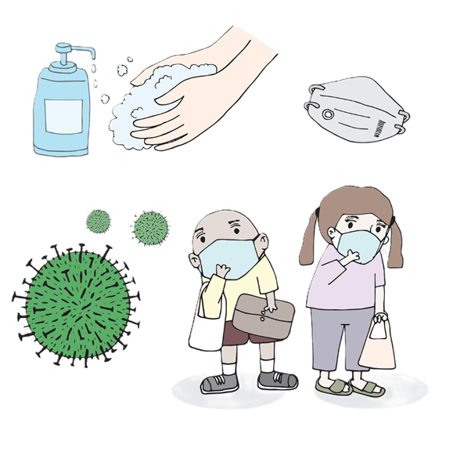
Participant Orientation
Principals of safe food handling
Food poisoning can be life-threatening.
Principals of safe food handling:
    Personal hygiene
    Hand-washing
    Cleaning and sanitizing
    Temperature control
    Proper storage and holding of food
Participant Orientation
Notes:
Food poisoning can be life-threatening. It is essential to teach the basic principles of food safety to participants during the orientation and to reinforce them throughout the series. Some of the Key topics to cover include:
Personal Hygiene; Emphasizing the importance of cleanliness and proper hygiene. Hand Washing; Demonstrating effective handwashing techniques to prevent contamination. Cleaning and Sanitizing; Educating on the difference between cleaning and sanitizing, and the importance of both. Safe Food Handling; Discussing practices to ensure food is handled safely during preparation and cooking. Temperature Control: Teaching participants about safe cooking temperatures and proper food cooling methods. And finally, Proper Storage and Holding of Food; Highlighting best practices for storing food to maintain safety and freshness.

Slide 18
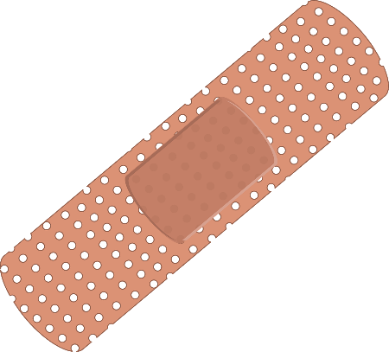
Participant Orientation
Personal hygiene practices:
Tie long hair back
Remove dangling jewelry, watches and rings
Do not cook when unwell.
Cover cuts and wounds with a bandage and gloves.
Unless a glove is being used to cover a cut, it is not needed. Gloves can compromise food safety.
Notes:
It is essential to teach participants in the program about the importance of practicing proper personal hygiene when cooking. Before starting any cooking activity, participants should follow these guidelines:
Ensure long hair is secured and tied back to prevent it from coming into contact with food. It can be helpful to have extra hair ties on hand for this purpose. Remove dangling jewelry including rings, or watches and store them safely to avoid contamination. If a participant isn’t feeling well, it’s best for them to refrain from cooking that day-- A sample of the food prepared can be set aside for them to try later. If a participant has a cut or wound, they should wash the area thoroughly, cover it with a band-aid, and wear a glove on that hand to ensure safety. Gloves are not necessary unless covering a cut. Frequent handwashing while cooking is the most effective way to prevent the spread of bacteria. It’s important to note that gloves can increase the risk of contamination if not used properly and changed regularly.

Slide 19
Participant Orientation
Handwashing:
The most effective way to stop the spread of illness
Handwashing is recommended over alcohol-based hand cleansers.
Hands should be washed:
  before starting to cook;
  after touching hair or face;
  after using the washroom;
  after handling raw meat, poultry, or eggs;
  after switching food preparation tasks or handling the garbage or dirty dishes.
Wearing gloves does not replace handwashing
Participant Orientation
Notes:
The best method for stopping the spread of illness is handwashing, which is recommended over alcohol-based hand cleansers for food preparation. Wearing gloves does not replace handwashing​. Participants should be aware of key moments when they must wash their hands, including:
Before starting to cook to ensure a clean start. After touching hair or face., After using the washroom. After handling garbage or dirty dishes. After handling raw food; This includes meat, poultry, or eggs. As well as when switching food preparation tasks.
By following these guidelines, we can significantly reduce the risk of foodborne illnesses and promote a safer cooking environment for all participants.

Slide 20
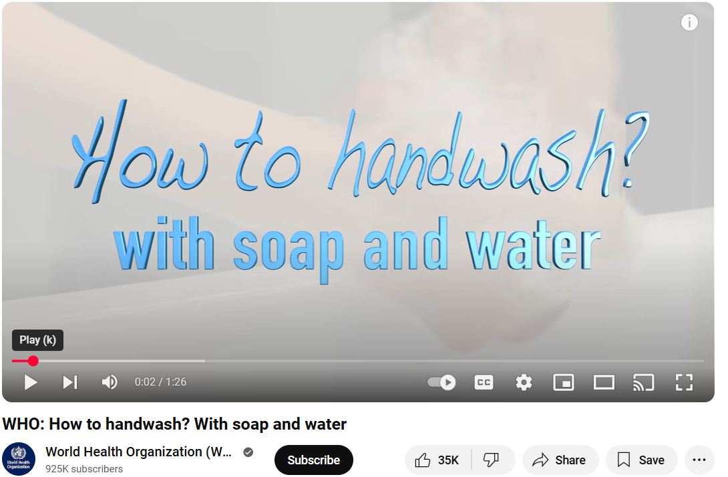
Proper Handwashing Technique
Participant Orientation
World Health Organization: How to handwash? With soap and water
https://www.youtube.com/watch?v=3PmVJQUCm4E
Notes:
This video demonstrates the proper technique for effectively washing hands.
Transcript:
Hand Washing should take you about 1 minute. Use a timer or count from one to ten in each of the following steps:
Wet hands with water and apply enough soap to cover all surfaces of the hands. Let the water run smoothly to avoid touching the tap later on.
Rub hands palm to palm to obtain a good quantity of foam. Then rub right palm over the back of left hand with interlaced fingers, and vice versa. Rub again palm to palm, with fingers interlaced.
Rub the back of your fingers to opposing palms with fingers interlocked, repeating this action for each hand. Rub rotationally left thumb clasped in right palm, and vice versa.
To clean the tips of the fingers, rub rotationally backwards and forwards, with clasped fingers of right hand in left palm, and vice versa. Rinse hands thoroughly with running water.
Dry hands thoroughly with a single-use towel. If the tap is not elbow operated, use this towel to turn off the tap without touching it directly.
Your hands are now clean and safe.

Slide 21
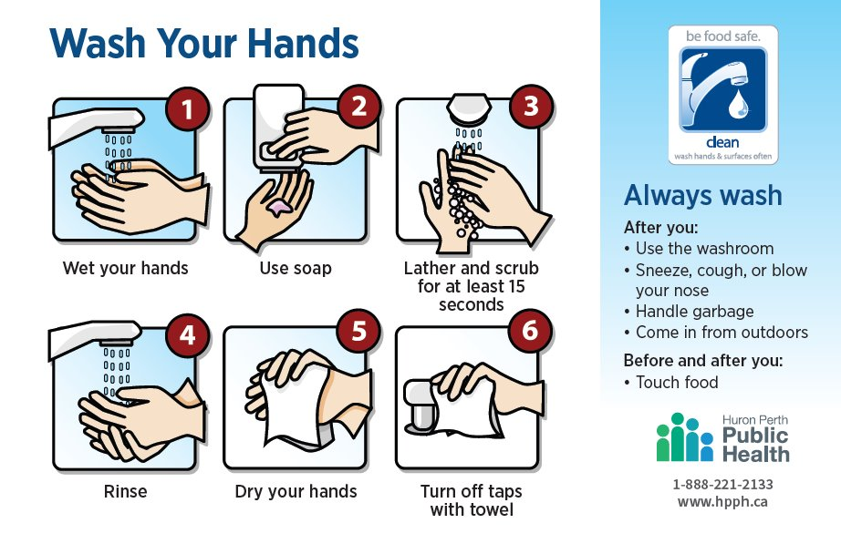
Participant Orientation
Notes:
This poster illustrates the six essential steps involved in proper handwashing as described in the previous video.
A copy of the poster is available on the portal and can be printed and displayed as a helpful reminder in the room where cooking sessions will take place.

Slide 22

v
Participant Orientation
Safe food handling: Vegetables and Fruit
Wash your hands before handling
Cut away any bruised or damaged areas
Thoroughly wash vegetables and fruits
Use a produce brush for items with firm surfaces
Use a separate cutting board for produce
If using meat, designate a separate cutting board
Notes:
When it comes to safe food handling, it's essential to ensure that all vegetables and fruits are thoroughly washed prior to any food preparation or cooking. Here are some Cleaning Guidelines for produce:
Always wash your hands with soap and warm water for at least 20 seconds before handling food.
Cut away any bruised or damaged areas on fruits and vegetables, as harmful bacteria can thrive there. Remember to clean your knife with hot, soapy water before using it again.
Rinse fruits and vegetables thoroughly under fresh, cool, running water, even if you plan to peel them. This helps prevent the spread of any bacteria that may be present. Some items, like bananas, do not need washing before peeling.
For items with firm surfaces (e.g., oranges, melons, potatoes, carrots), use a clean produce brush to scrub them. There is no need for special produce cleansers.
Pre-washed, bagged leafy greens can be eaten without further washing, while pre-cut leafy greens sold in open bags or containers should be washed before consumption.
While this program does not include raw meat, poultry, fish, and seafood. If you were using them, for food safety reasons, we recommend designating one cutting board for produce and a separate one for raw meat, poultry, fish, and seafood, to avoid cross-contamination.
Handling meat safely requires attention to detail and food safety procedures. Because of is it is not recommended to prepare meat in a non-kitchen classrooms or community setting. Excluding meat helps to ensure participant safety without placing undue pressure on facilitators to meet precise meat handling protocols.
For more information on handling produce safely, you can refer to Health Canada’ Food Safety website (link provided in notes). https://www.canada.ca/en/health-canada/services/general-food-safety-tips/produce-safety.html

Slide 23
Participant Orientation
Safe food handling: Shopping Tips
Always select cold or frozen items at the end of your shopping trip.
Inspect fruits and vegetables closely, avoiding bruises.
Ensure ready to eat foods have been properly refrigerated at 4°C or below.
Keep fresh fruits and vegetables separate from meat, poultry, and seafood in your shopping cart and bags.
Regularly clean your reusable grocery bags.
Notes:
Food safety starts at the grocery store. Here are some helpful shopping tips to ensure proper food safety.
Always select cold or frozen items at the end of your shopping trip to ensure they stay at safe temperatures. Inspect fruits and vegetables closely, avoiding any that are bruised or damaged. When purchasing pre-cut or ready-to-eat fruits and vegetables, ensure they have been properly refrigerated at 4°C or below. They should be displayed in a refrigerated container, not just sitting on ice. Keep fresh fruits and vegetables separate from meat, poultry, and seafood in your shopping cart and bags. Regularly clean your reusable grocery bags to maintain hygiene.

Slide 24
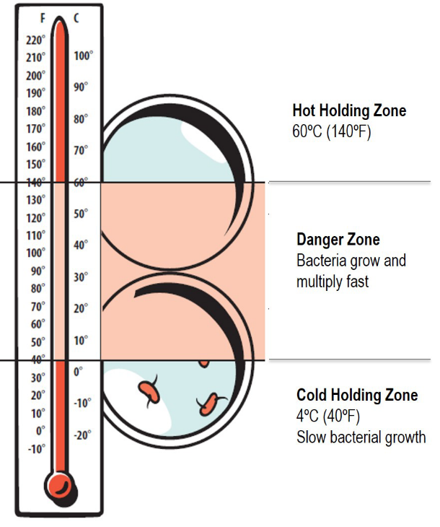
Participant Orientation
Safe food handling: Danger Zone
Temperature zone where bacteria grow most rapidly ​
Between 4°C and 60°C (40°F and 140°F) ​
Keep refrigerated, frozen and cooked food out of this zone ​
Foods in this zone for more than 2 hours are not safe to eat
Keep cold food at or below 4°C and hot foods above 60°C for holding purposes ​
How would you help to keep foods out of the ‘danger zone’?​
​
Notes:
The temperature zone where bacteria grow most rapidly is between 4°C and 60°C (or 40°F and 140°F), this is referred to as the danger zone. It is crucial to keep refrigerated, frozen, and cooked foods out of this danger zone to prevent foodborne illnesses.
It is important to remember that foods that remain in this temperature zone for more than 2 hours are no longer safe to eat. Always keep cold foods at or below 4°C and hot foods above 60°C for holding purposes. Cool hot foods down quickly to minimize their time in the temperature danger zone.
As facilitators, it’s important to consider and discuss strategies for keeping foods out of the danger zone during your program.

Slide 25


Participant Orientation
Safe food handling: Eggs
Choose only graded, refrigerated eggs with clean, un-cracked shells
Store in the coldest part of the refrigerator
Wash hands before and after handling eggs
Cook eggs thoroughly until both the yolk and white are firm and not runny (internal temperature of at least 74°C/165°F).
Follow proper cleaning and sanitizing techniques to avoid cross-contamination.
Notes:
Although this program primarily uses low-risk ingredients, eggs are included in some recipes and can potentially carry the bacteria Salmonella. To minimize risk, we ask that you use only graded eggs with clean and uncracked shells. Grade A or Grade B eggs are acceptable. When handling eggs, be sure to follow these safety tips:
Store eggs properly by keeping them in the coldest part of the refrigerator to maintain freshness and safety. Practice proper handwashing by always washing hands with warm water and soap for at least 20 seconds before and after handling eggs. Cook eggs thoroughly to ensure that both the yolk and white are fully cooked and firm, not runny. Prevent cross-contamination by following proper cleaning and sanitizing techniques by using warm water, soap, and food-grade sanitizer to thoroughly wash utensils, countertops, and cutting boards after handling raw eggs.

Slide 26
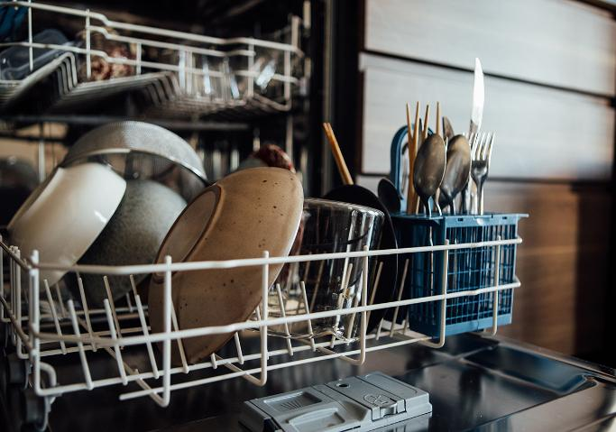
Participant Orientation
Cleaning & sanitizing, dishes, pots, and equipment:
By machine:
Use a commercial grade dishwasher that meets the Ontario Food Premises Regulation (O. Reg 493/17)
Notes:
To properly clean and sanitize equipment in a dishwasher, it must be commercial grade and comply with the Ontario Food Premises Regulation (https://www.ontario.ca/laws/regulation/170493). Commercial dishwashers typically have an external temperature gauge to ensure proper sanitizing temperatures are met. This regulation outlines the minimum standards that all food premises must adhere to for food safety. By using a commercial-grade dishwasher that meets these standards, you can ensure that all equipment is thoroughly sanitized and safe for use in your program.

Slide 27

Cleaning & sanitizing: dishes, pots & equipment
Handwashing dishes:
Three compartment sink (or bins) for washing dishes by hand is required
Participant Orientation
Notes:
Many locations may not have access to a commercial dishwasher. In such cases, dishes will need to be handwashed using the three-compartment sink method. The next two slides will provide a detailed overview of this method, ensuring that all equipment is properly cleaned and sanitized.

Slide 28
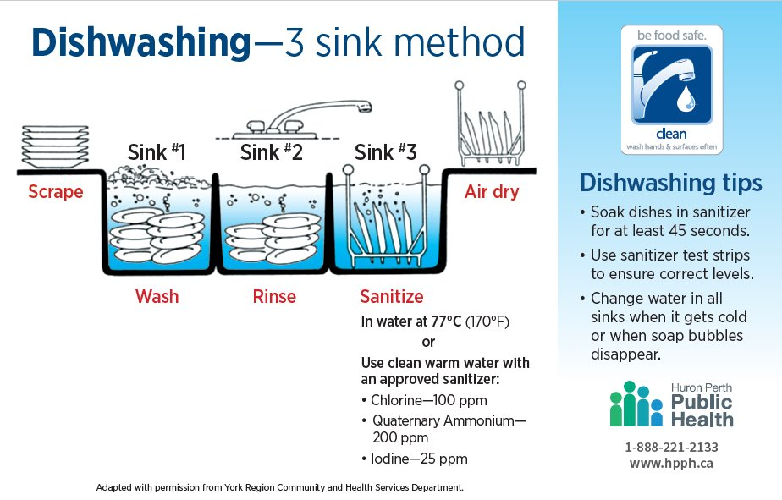
Participant Orientation
Notes:
When handwashing dishes using the three-sink method, follow these steps to ensure proper cleaning and sanitizing:
First, scrape off any excess food and rinse the dishes before starting the washing process. Next, ensure all sinks are clean. Fill the first sink with warm, soapy water, and wash the dishes thoroughly in this sink. Then, fill the second sink with clean warm water, to rinse the dishes. If a three-sink setup is unavailable, clean bins can be used instead. In the third sink, sanitize the dishes using a food-grade sanitizing solution, such as chlorine (also known as bleach), quaternary ammonia, or iodine, following the appropriate dilution instructions. Finally, allow the dishes to air dry or dry them with paper towels. Afterward, store the dishes in a clean, safe, and secure location.

Slide 29

Participant Orientation
Sanitizing solutions:
Suma Quat D4 Sanitizer and Quatromyice II RTU are examples of a food grade quaternary compound that can be purchased to sanitize.
Follow the manufacturer's directions
Must be 200 ppm - use test strips
Start with 1-2 Tbsp per/sink, add as needed
SDS Sheets are included in the kits
Use PPE
Participant Orientation
Notes:
Before choosing a food-grade sanitizer, check with your school administration or agency to determine the appropriate type to use. Suma Quat D4 Sanitizer and Quatromyice II RTU are examples of food grade quaternary compounds that can be purchased for sanitizing.
It is important to follow the manufacturer’s directions carefully. Use test strips to ensure the concentration of the solution is safe, start with 1-2 tablespoons per sink, adjusting as needed. Always use the recommended personal protective equipment (PPE) when handling sanitizers for safety. For quaternary ammonium compound, this includes goggles and gloves when handling the undiluted product.
The next slide will feature a video demonstrating how to properly use a quaternary compound sanitizing solution.

Slide 30
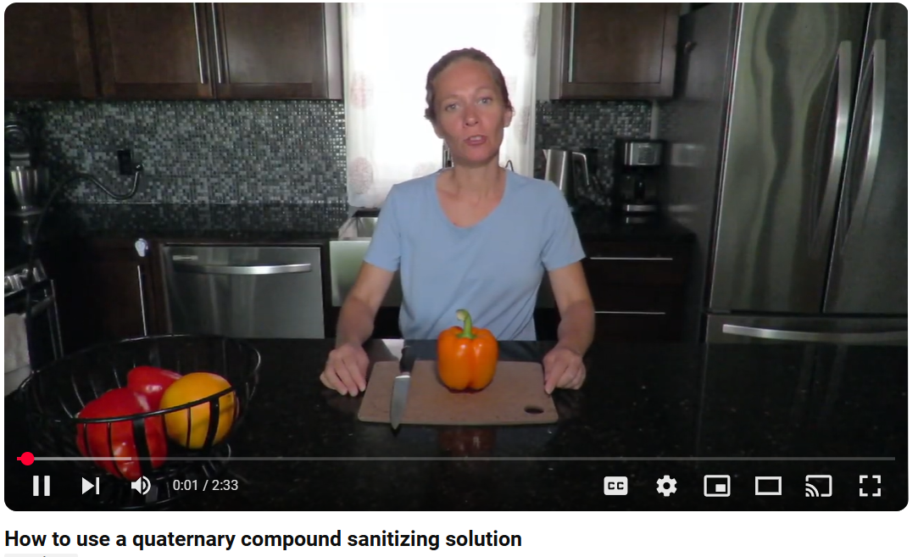
Participant Orientation
Using a quaternary compound sanitizing solution
Watch on YouTube: https://www.youtube.com/watch?v=1KmGnVG5p2o
Notes:
Transcript:
This demonstration will show you how to dilute and use quaternary compound food grade sanitizing solution. The diluted sanitizing solution is used to sanitize cooking surfaces before and after use and also used to sanitize dishes after they have been washed and rinsed.
All dishes and equipment needed for cooking sessions should always be washed, rinsed and sanitized before use. To sanitize the cooking surfaces, dilute the sanitizing solution to the proper concentration and put into a spray bottle like this one. It's important to label the spray bottle according to WHMIS requirements.
To sanitize the dishes or equipment, use a clean sink or bin. Fill the bin with hot water that is at least 24 degrees Celsius or 75 degrees Fahrenheit and dilute the sanitizing solution to the proper concentration.
Here are the steps to follow when diluting the food grade sanitizer to the proper dilution. Before you start, read the instructions on the product label and identify any type of protective equipment to be worn when using the sanitizer and be aware of any important safety information. For this sanitizer, it is recommended that goggles and gloves are worn for protective equipment. Quaternary ammonium sanitizers, such as this one, should be diluted to a concentration of 200 parts per million. Once added, stir with a large spoon.
Now let's test the solution to ensure it is at 200 parts per million. Take a piece of sanitizer test strip-- which you will need to purchase when you buy the food grade sanitizer, make sure it is for quaternary ammonium compound. Dip the test strip in the solution, remove the test strip from the solution and check the test strip against the color indicator on the test strip container. The test strip should be similar in color to the color indicator of 200 parts per million.
Before sanitizing any dishes, transfer some of the solution into a labelled spray bottle which can be used to sanitize cooking surfaces. Once your dishes are washed and rinsed you can place your dishes into the sanitizing solution and leave them for 60 seconds to ensure they are properly sanitized. After this, you are ready to go!

Slide 31

Knife Safety
Participant Orientation
Carry knives with blade pointed down towards the floor
If the knife falls - back up and let it fall
A dull knife can be more dangerous than a sharp one
Always hold the knife by the grip or handle
Always cut DOWN and AWAY from the body
Always use a cutting board
Ensure cutting board is secure and not moving
Always wear closed toe shoes
Notes:
Since knives will be used extensively in the program, it’s essential that participants receive instruction and practice on safe knife handling.
Here are some key points to emphasize during the lesson:
Always carry knives with the blade pointed down towards the floor. If a knife falls, step back and let it fall—never try to catch it. A dull knife can be more dangerous than a sharp one, so keep knives sharpened.
Always hold the knife by the handle or grip, never by the blade. Cut down and away from the body to avoid accidents. Use a cutting board for stability and safety—ensure its secure and not moving. Lastly, always wear closed-toe shoes while working in the kitchen for additional protection.
The following video will include key safety tips to communicate and demonstrate to participants to ensure safety when using a knife. The content of this video and slide is summarized in a resource in the facilitator materials.

Slide 32
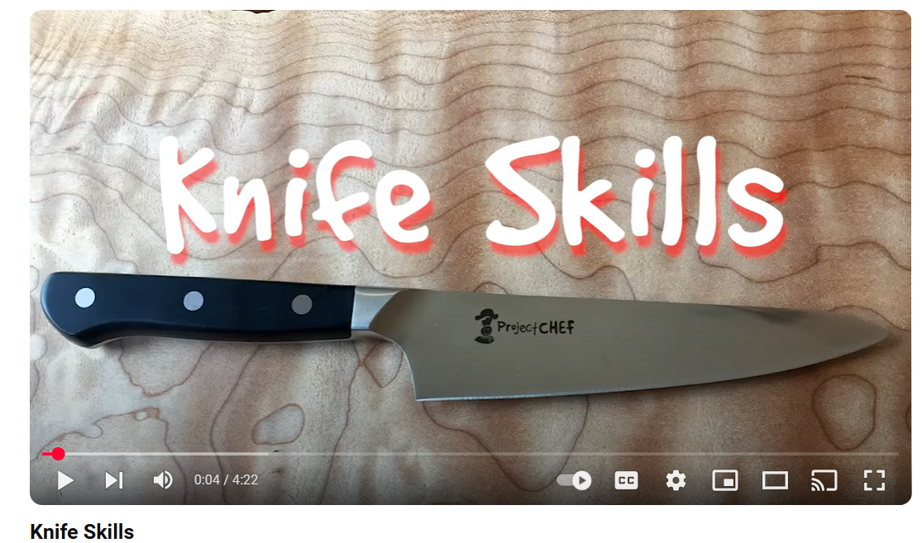
Knife Safety
Participant Orientation
Watch on YouTube: https://www.youtube.com/watch?v=fe3Mo_IzmT8
Notes:
Transcript:
Welcome to project chef let's look at knife skills.
Cutting board: Before you start cutting with a knife you want to be sure your cutting board is secured in place. If your cutting board is sliding around as you're trying to cut, you're an accident waiting to happen. It's easy to stop it from sliding, simply put a damp paper towel under your cutting board and it won't go anywhere. Now you're ready to cut.
Holding a knife: With smaller hands we use sharp paring knives and they can be used to cut pretty much anything. Cutting safely is a two-handed job. You want to hold your knife with the hand you write your name with. You don't want to hold the knife far back on the handle as you just don't have good control of the knife. You also don't want to put your index finger on the top of the knife blade as this doesn't give you good control. The knife could even mistakenly be blade side up and that really not be safe.
Cutting - the claw: The hand that's not holding the knife is just as important as the knife end. It's important to hang on tightly to what you're cutting and to do so use the claw. Hold your hand out in front of you, roll your fingertips down into a claw turn your elbow out so that the claw hand is in a good position for cutting. Be careful where your thumb goes. If you hang on to your ingredient with a pinch, your thumb is exactly in the wrong place for cutting. If you cut yourself, I guarantee it'll be on your thumb. To be safe make a claw, pop your elbow out to the side, put the heel of your hand on the cutting board and be sure your thumb is tucked in. Your claw hand will guide your knife but your fingers will still be safe.
Cutting - the saw: Once you have your claw hand in the correct position, you're ready to cut. We cut ingredients using a saw. Holding the knife in the correct position at the front of the handle and not on the blade, move your knife forwards and backwards, sawing through the ingredient. Try not to push too hard, let the knife do the work. Don't push the ingredient with a lot of pressure, as this is not a safe way to cut.
The teeter-totter: When you are cutting, you always want to cut something on a flat surface so it's not rolling around. It's safer when what you're cutting isn't moving. When cutting larger ingredients, sometimes your knife can get stuck. Don't try to pull the knife out. Instead, teeter-totter your way through the ingredient until you've cut through safely. Always look for a flat surface, hold your knife safely, claw- to keep the ingredient from moving, saw through. If you get stuck, teeter-totter to finish the job.
Now that we've looked at the different knife skills, let's put them all together. To cut something, hold on to the ingredient with a claw. Cut the ingredient using a sawing motion. Scoop up what you cut in one fell swoop with our favorite tool Fred. it's actually a pastry scraper but a student named it and it stuck-- it's a pretty handy tool. Place the ingredient flat side down, teeter-totter. if your knife gets stuck, claw and saw through the ingredient. Take your time. When you finish cutting, always put your knife at the top of the cutting board so you know where it is. Scoop up what you've cut with Fred and pop into a bowl. Clean up your cutting board for the next job because a clean cook is a safe cook.
Now it's your turn to cut.

Slide 33
Participant Orientation
General kitchen safety:
Preventing Burns:
Always use oven mitts to lift hot items
Ask for help when carrying hot items that are too heavy
Preventing Shocks:
Hands must be dry when plugging in electrical equipment to an outlet
Turn off appliance before plugging it in
Notes:
For general kitchen safety, it’s essential to take precautions to prevent injuries and accidents.
To prevent burns, always use oven mitts when lifting hot items. Remind participants that if a piece of equipment is too heavy or awkward, they should ask for help to avoid any accidents. To prevent electric shocks, ensure that hands are completely dry before plugging any electrical equipment into an outlet. Additionally, make sure the equipment is turned off before plugging it in to avoid any sudden power surges or malfunctions.

Slide 34
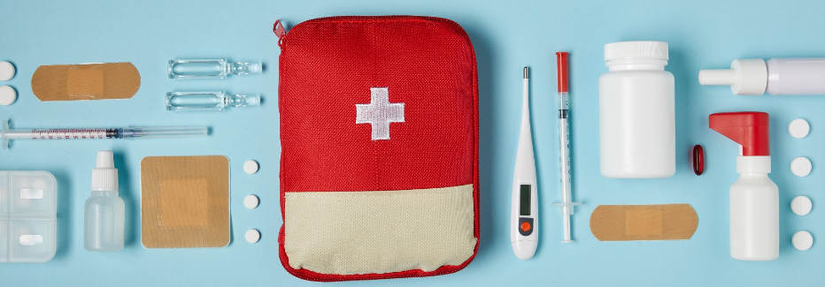
Participant Orientation
Handling injuries:
A first aid trained staff member must be available at all times when the program is running
Know where the first aid station is located
If a participant cuts themselves, clean the wound and apply a sterile Band-Aid
Contact the first aid trained staff member
Notes:
While first aid training is not a requirement for facilitators, it is necessary to have someone with first aid training present and available whenever the program is running. It’s also important to always know where the first aid station is located.
If a participant cuts their hand or finger, immediately clean the wound and apply a sterile band aid. To continue participating, the participant must wear a glove on the injured hand. Any food or equipment that has come into direct contact with the wound must be discarded. The equipment should be thoroughly cleaned and sanitized before further use.

Slide 35
Program
Format
Program consists of 7 sessions in total:
Session One: orientation (mandatory)
  Food, kitchen, and knife safety
  Participants prepare and taste one recipe
  Additional Sessions:
6 themed cooking sessions
Each session includes 2 recipes for participants to prepare and taste
Ratio of 1 facilitator to 5 participants is recommended for safety reasons
Notes:
The Let’s Get Cookin’ Program is made up of 7 sessions in total. The first session is the orientation, and it is mandatory for all participants. During this session, you will cover essential topics such as food safety, kitchen safety, and knife skills. Participants will also prepare one recipe to get hands-on practice.
After the orientation, there will be 6 themed cooking sessions. Each of these sessions will feature 2 recipes that the participants will prepare.
For safety reasons, it is recommended to maintain a 1 facilitator to 5 students ratio during all cooking sessions.

Slide 36
Program
Format
Orientation layout:
Collect consent forms
Complete attendance form
Provide overview of program
Set ground rules
Review food and kitchen safety
Notes:
Now we’ll go into a bit more detail about what is expected in the orientation session.
At the start of the first session, you’ll need to collect the consent forms signed by parents or guardians. This session will focus on providing an overview of the program, introducing participants to food safety, safe knife handling, and establishing the ground rules for the program. Participants will also get a chance to practice their knife skills by preparing one of the recipes from the orientation recipe section. To help track participation throughout the program, attendance forms are available on the portal for use in each session.

Slide 37

Cooking Sessions
Two recipes (stations) per session:
Recipes are themed, contain either a vegetable or fruit, and are easy to prepare in minimal time
Limited equipment required - no oven needed
For each recipe:
  Shopping lists included
  Equipment lists included
Notes:
Once the orientation session is complete, the cooking sessions will begin!
Each of the six cooking sessions is themed and includes two recipes for participants to prepare. On average, each recipe takes about 30 minutes to complete, although some may require a bit more time. The recipes are designed to be simple, either requiring no cooking or just the use of a skillet.
For your convenience, both a shopping list and an equipment list are provided for each recipe, and all of these resources can be accessed on the portal.

Slide 38

Cooking Sessions
Recipe Reading
Encourage participants to read the full recipe before starting
Highlight the importance of understanding steps before cooking
Encourage asking questions if uncertain
Mistakes are learning opportunities!
Notes:
Before starting to cook, encourage participants to read through the entire recipe carefully so they understand the process, identify all necessary ingredients, and anticipate any challenging steps.
Participants should take charge of checking that all the required ingredients are available and properly measured. This helps ensure a smooth cooking experience without interruptions. They should also be responsible for ensuring their workspace is setup, making sure all tools and equipment are clean, organized, and ready to go. By preparing ahead, they’ll create an environment that’s not only efficient but also enjoyable to cook in.
Remind participants to follow the recipe in order without skipping ahead, to ensure consistency and reduce mistakes. Encourage them to ask questions if they’re unsure about anything. This empowers them to take ownership of the cooking process and helps foster a supportive learning atmosphere. Remind participants that mistakes are a normal part of the cooking process and should be seen as opportunities to learn and troubleshoot together. Encourage them to stay patient and work through any challenges, turning errors into valuable learning experiences.

Slide 39
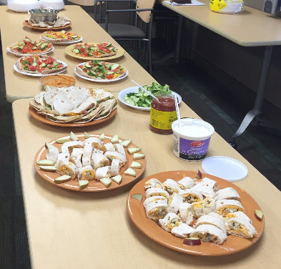
Cooking Sessions
Six themed cooking sessions:
Begin with Breakfast
Versatile Veggies
Dinner Delights
Spice it Up!
Winning Weekends
Fabulous Fruit
Notes:
As previously mentioned, each cooking session is organized around a specific theme, such as "Begin with Breakfast," “Versatile veggies”, "Dinner Delights," "Spice It Up!", “Winning weekends” and “Fabulous fruit”. It is essential to follow the recipes closely to ensure a successful cooking experience.
In case you encounter challenges sourcing certain ingredients or if they are too expensive, the portal provides helpful suggestions for minor substitutions to keep your sessions running smoothly.

Slide 40
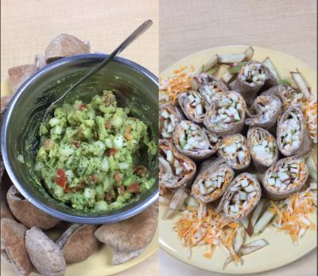
Cooking Sessions
Sampling:
Participants can try food once it’s all prepared
Allow participants to decide whether or not they want to taste the food
Create a positive tasting/eating environment:
  Have participants plate food in an appealing way
  Set up tasting table on a clean and sanitized table
  Provide a water pitcher when sampling foods
Notes:
At the end of each cooking session, participants will have the opportunity to sample the dishes they’ve prepared. Encourage groups to present their creations in an attractive manner on the serving dishes. If possible, arrange for the group to sit down and enjoy the meal together, consider setting up a tasting table that looks inviting, complete with tablecloths, sampling plates or bowls, and cutlery.
Always make water is available. Provide a water pitcher or encourage participants to bring their own water bottles. If possible, encourage participants to bring their own reuseable plates and utensils, otherwise, make disposable plates and cutlery available.
Everyone will have the opportunity to try all the dishes. As facilitators, it’s our responsibility to foster a positive environment where everyone can socialize and savor the delicious food! It's entirely up to each participant whether they choose to try a particular dish. Participants have lots of different reasons why they may be hesitant to try new foods and foods prepared in new ways. It’s important that participants don’t feel obligated to taste the food. Avoid saying things like, “Just take one bite,” or “You have to try it.” Instead, say something more neutral like, “Feel free to try it if you like, no pressure!” to avoid creating negative experiences for participants
Encourage Curiosity – Instead of focusing on whether someone “likes” or “dislikes” a dish, ask curious questions that focus on the experience: “What do you notice about the texture or flavor?” “What part of this dish do you enjoy?”
By maintaining this judgment-free environment, we help participants feel safe and comfortable, encouraging them to explore new foods at their own pace and in their own way. The goal is to nurture a positive relationship with food that centers around enjoyment, discovery, and autonomy, rather than pressure or comparison.

Slide 41






Sampling
Focus on the Sensory Aspects of Food
5 Senses
Notes:
When participants sample the dishes they've made, encourage them to engage all five senses in the experience. This is a good opportunity to practice using descriptive language.
Sight – Notice the colors, textures, shapes and presentation of the food. Encourage participants to take a moment to appreciate how the dish looks on their plate.
Smell – Before tasting, ask participants to smell the dish and notice the different aromas. Does it smell savory, sweet, or spicy?
Touch – For some foods, texture can play a big role. Encourage them to feel the texture with their utensils or even with clean hands for finger foods.
Hearing – While this sense is less obvious, it’s possible to hear crunchiness or sizzling, which adds to the experience. Invite participants to listen for any sounds that come from biting into the food.
Taste – Finally, encourage participants to focus on the flavors, including sweetness, saltiness, spiciness, or bitterness. They don’t need to love everything they taste, but they can appreciate the experience.

Slide 42


Congratulations!
You have completed the online training module!
Please click the link below to access the quiz and portal:
Let's Get Cookin’! Quiz
For additional questions, contact us:
LGC@hpph.ca
Notes:
Congratulations! You have successfully completed the e-learning module. The final step to facilitate the program in your organization is to complete a short online quiz that will test your knowledge and understanding of the material. To access the quiz, please click the link provided under the training module. Once you have completed the quiz, you will receive confirmation from us via email. After that, you'll be ready to run the Let's Get Cookin' program in your school or community. Happy Cooking!
Please contact us at LGC@hpph.ca should you have any questions about accessing the materials or implementing the program.
Quiz link:
Portal link: www.hpph.ca/LGCportal (password required)

